Slide 1

Continuous Delivery
Société Générale
Copyright © 2014-2015 Xebia. All rights reserved. Not to be reproduced without prior written consent.

Slide 2
About Trainers!
Copyright © 2014-2015 Xebia. All rights reserved. Not to be reproduced without prior written consent.
Copyright © 2014-2015 Xebia. All rights reserved. Not to be reproduced without prior written consent.

Slide 3
Workshop Overview
Overview of CI/CD
TDD
BDD
Clean Code, Refactoring, PairProg. & Design Patterns
CI
CD
Infrastructure as code
Copyright © 2014-2015 Xebia. All rights reserved. Not to be reproduced without prior written consent.
Notes:
Add Complete Agenda Here

Slide 4
Chapter 1
Overview of CI/CD
Copyright © 2014-2015 Xebia. All rights reserved. Not to be reproduced without prior written consent.

Slide 5
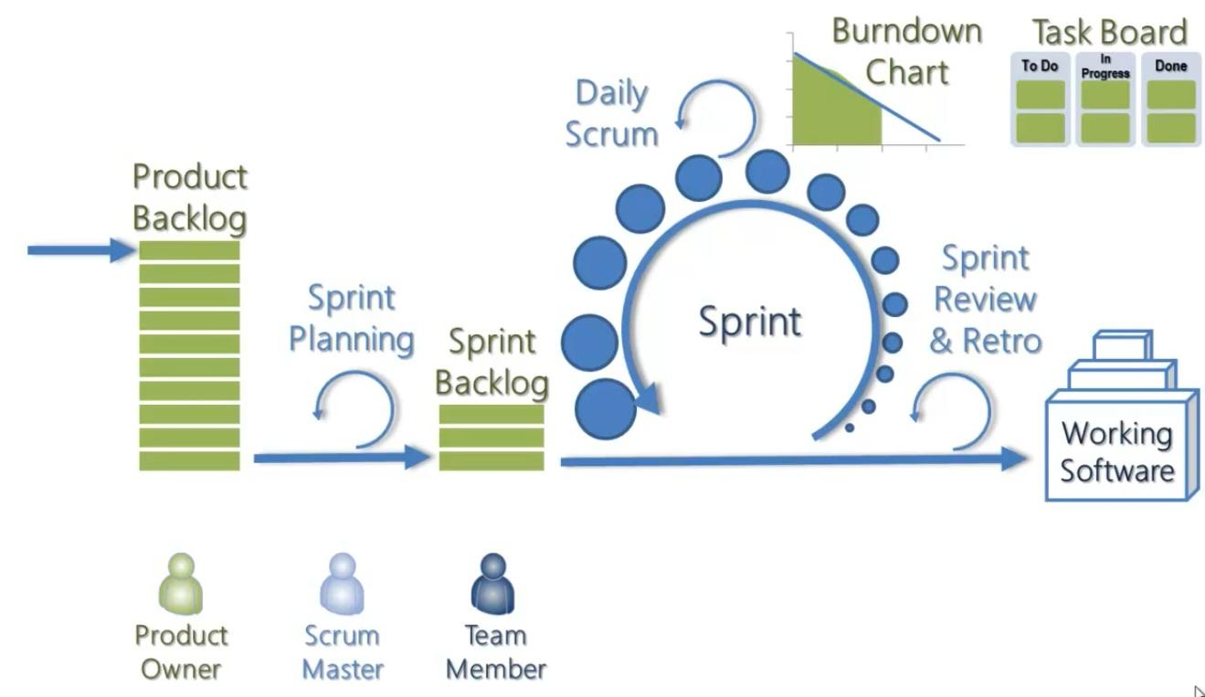
Last Mile Problem
?
Copyright © 2014-2015 Xebia. All rights reserved. Not to be reproduced without prior written consent.

Slide 6
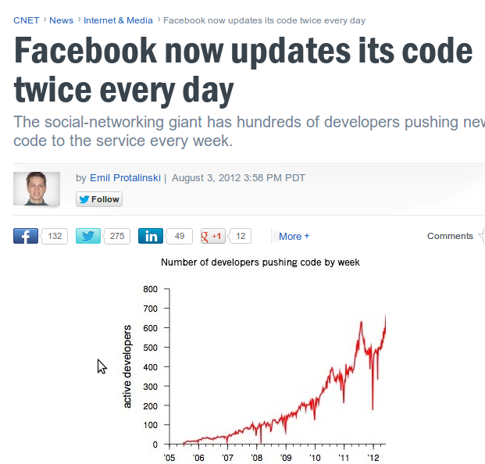


Amazon’s web infrastructure guru James Hamilton uses Facebook’s recently released energy data to make an educated guess for how many servers Facebook now has: potentially 180,000. That’s up from an estimated 30,000 in the winter of 2009, and 60,000 by the Summer of 2010.
google has more than one million servers
3 engineers
over 14 million users
no hardware
+100 instances on Amazon EC2
10 releases per day!
Copyright © 2014-2015 Xebia. All rights reserved. Not to be reproduced without prior written consent.

Slide 7
Need of the hour!
FASTER, EFFICIENT, ERROR-FREE, AUTOMATED DELIVERY OF SOFTWARE
Copyright © 2014-2015 Xebia. All rights reserved. Not to be reproduced without prior written consent.

Slide 8
Forrester Research survey
A recent Forrester Research survey of Fortune 1000 companies indicates that 58% of IT leaders in their companies place faster delivery of IT services in their top 3 priorities.
Yet, only 12% can deliver high quality results fast enough.
Copyright © 2014-2015 Xebia. All rights reserved. Not to be reproduced without prior written consent.

Slide 9
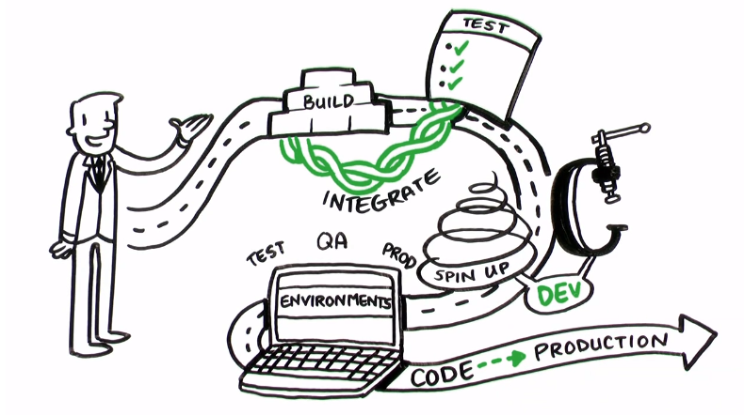
Introducing Continuous Delivery
Copyright © 2014-2015 Xebia. All rights reserved. Not to be reproduced without prior written consent.

Slide 10
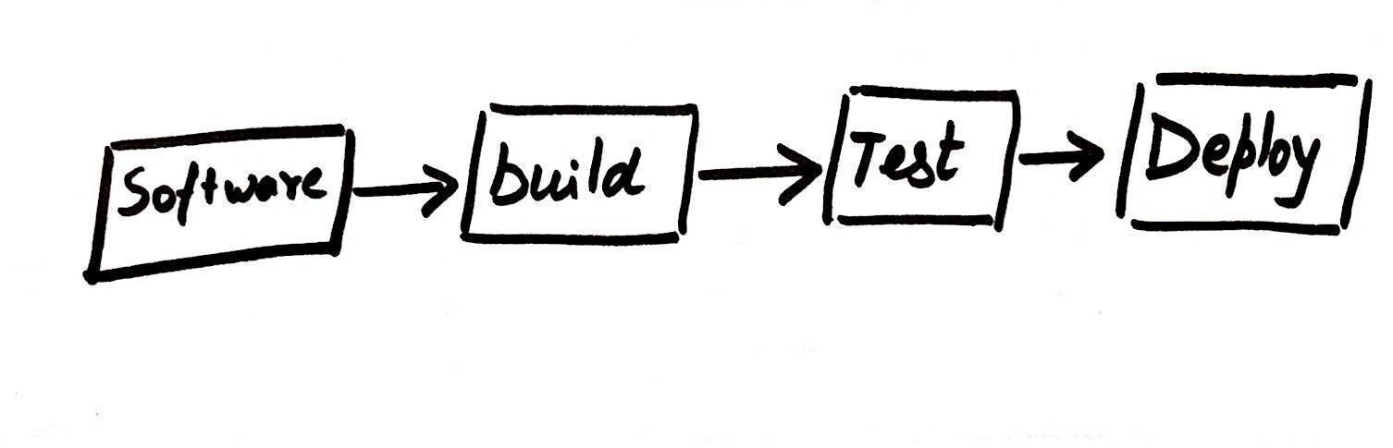
From Idea to Product
Copyright © 2014-2015 Xebia. All rights reserved. Not to be reproduced without prior written consent.

Slide 11
Definition of Done
Quality Code Compiled and UNIT TESTED
Deployed on an environment IDENTICAL to actual environment as much as possible
Meeting ALL the Acceptance Criteria and functionalities with AUTOMATED TESTING
Good to Go Live in ONE CLICK!
Copyright © 2014-2015 Xebia. All rights reserved. Not to be reproduced without prior written consent.

Slide 12

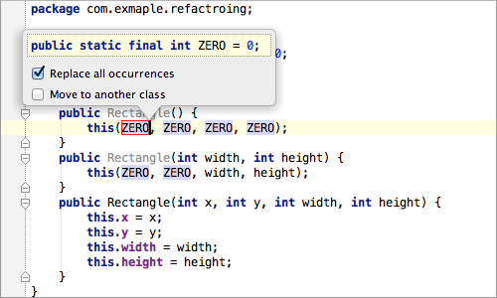
Starts from the First
Clean Code
Refactoring
OO Design
Principles
Copyright © 2014-2015 Xebia. All rights reserved. Not to be reproduced without prior written consent.

Slide 13
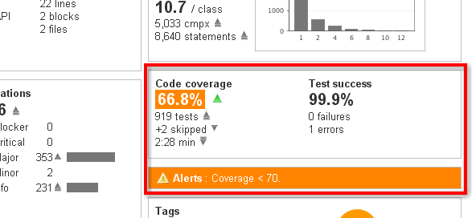
Code Quality Check Points
Code Quality - SONAR, PMD, Find Bugs etc.
Copyright © 2014-2015 Xebia. All rights reserved. Not to be reproduced without prior written consent.

Slide 14
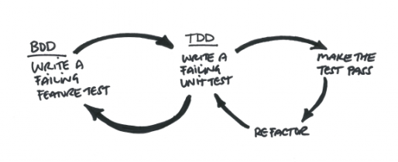
Unit Testing, TDD, BDD
Copyright © 2014-2015 Xebia. All rights reserved. Not to be reproduced without prior written consent.

Slide 15
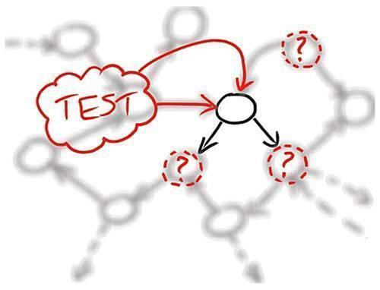


Mocking
Copyright © 2014-2015 Xebia. All rights reserved. Not to be reproduced without prior written consent.

Slide 16
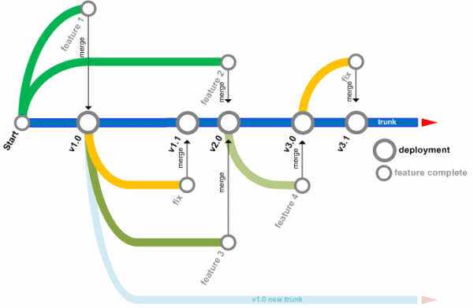

Source Control Management
Branching strategy and tools.
Copyright © 2014-2015 Xebia. All rights reserved. Not to be reproduced without prior written consent.

Slide 17





Automated Testing
Automated Functional and acceptance Testing.
Copyright © 2014-2015 Xebia. All rights reserved. Not to be reproduced without prior written consent.

Slide 18
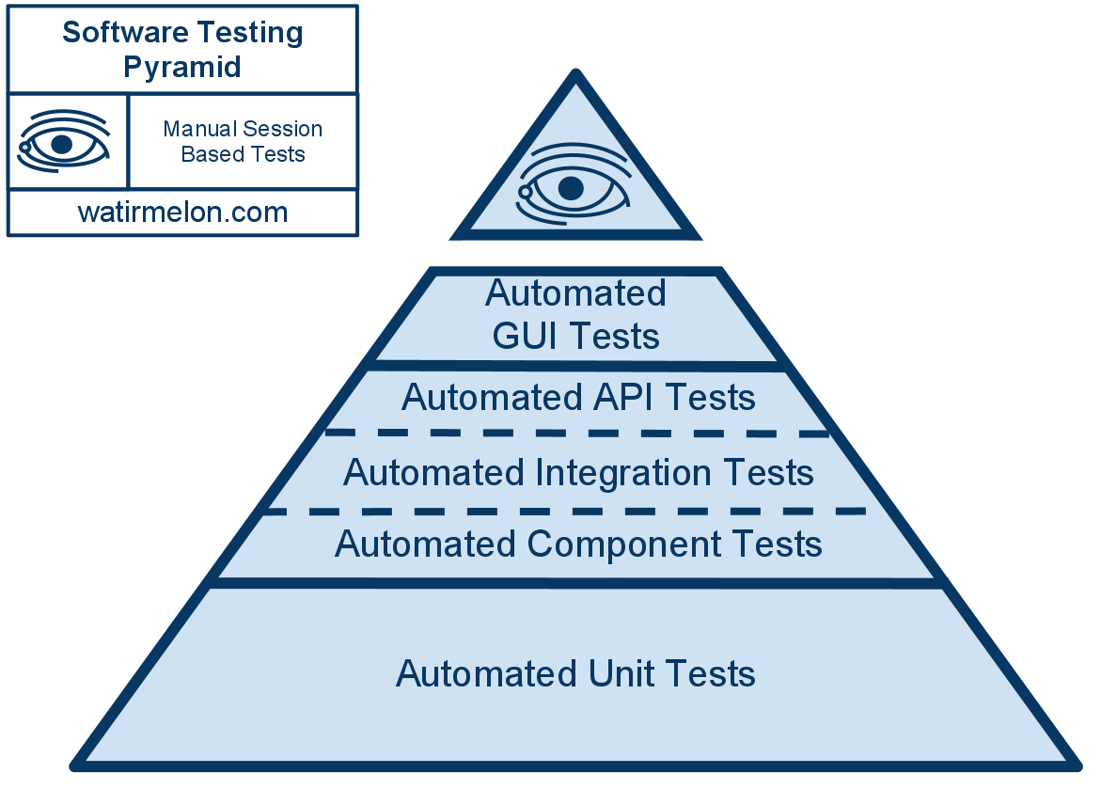
Test Strategy
Copyright © 2014-2015 Xebia. All rights reserved. Not to be reproduced without prior written consent.

Slide 19
Build Pipelines
Increases visibility of each step
Early feedback
Automate deploy and release any version to any environment.
Copyright © 2014-2015 Xebia. All rights reserved. Not to be reproduced without prior written consent.

Slide 20
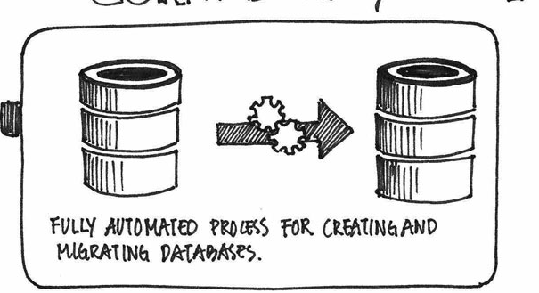
Managing Databases
Automated Process:
Inmemory databases
Rollback Scripts
Backups
Copyright © 2014-2015 Xebia. All rights reserved. Not to be reproduced without prior written consent.

Slide 21
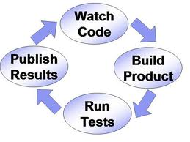
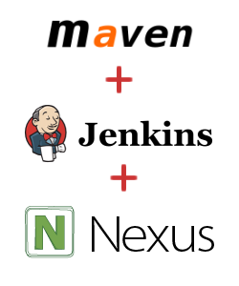
Continuous Integration
Copyright © 2014-2015 Xebia. All rights reserved. Not to be reproduced without prior written consent.

Slide 22
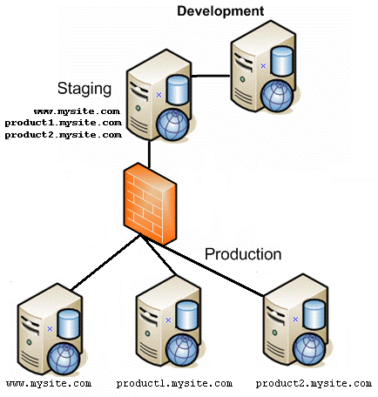
Automated Deployments
Copyright © 2014-2015 Xebia. All rights reserved. Not to be reproduced without prior written consent.

Slide 23
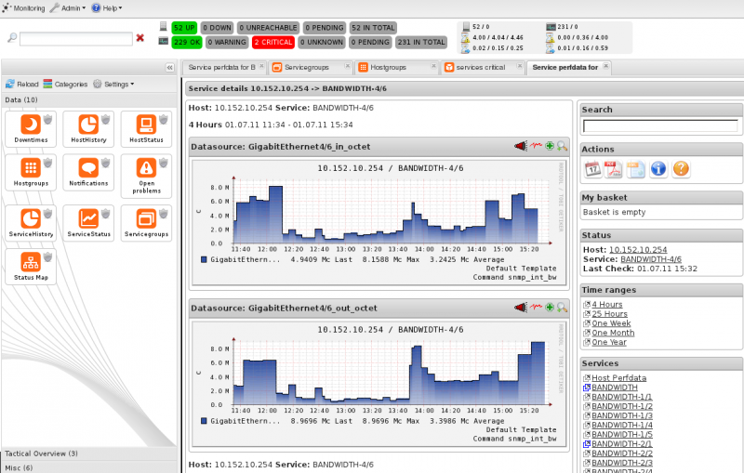
System Monitoring Dashboards
Copyright © 2014-2015 Xebia. All rights reserved. Not to be reproduced without prior written consent.

Slide 24
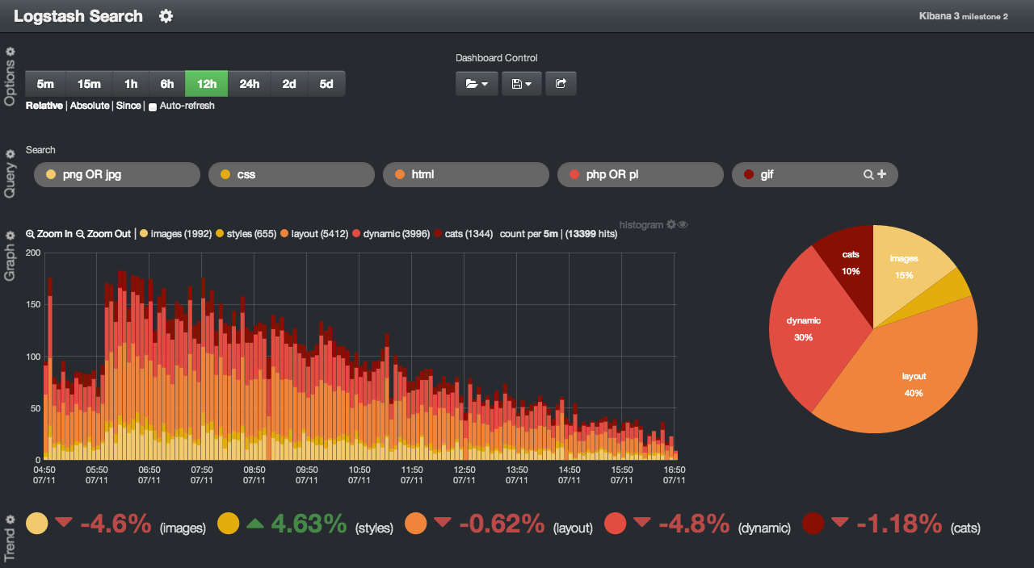
Logging Dashboard
Copyright © 2014-2015 Xebia. All rights reserved. Not to be reproduced without prior written consent.

Slide 25
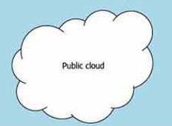

Provisioning and On Demand Infrastructure
Copyright © 2014-2015 Xebia. All rights reserved. Not to be reproduced without prior written consent.

Slide 26
Infrastructure of code
“A flexible model for reuse by enabling users to model infrastructure as code to easily and consistently configure and deploy infrastructure across any platform.
Create a blueprint of your infrastructure that enables you to build or rebuild, automatically in minutes or hours – not weeks or months."
Copyright © 2014-2015 Xebia. All rights reserved. Not to be reproduced without prior written consent.

Slide 27
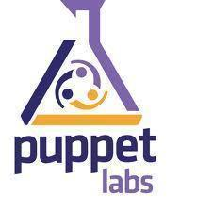
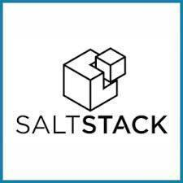






Tools of the Game
Copyright © 2014-2015 Xebia. All rights reserved. Not to be reproduced without prior written consent.

Slide 28
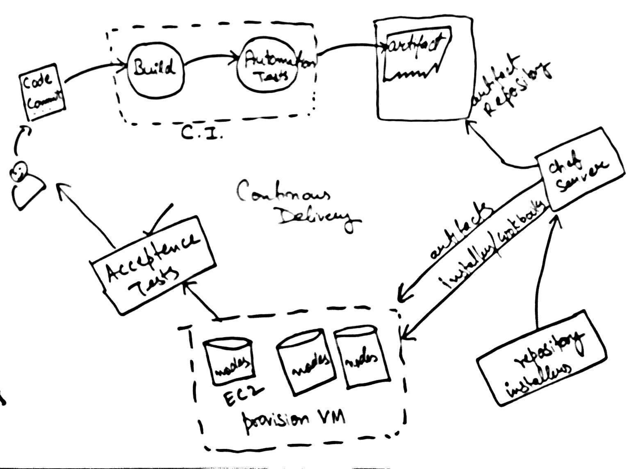
The concept of CD
Copyright © 2014-2015 Xebia. All rights reserved. Not to be reproduced without prior written consent.

Slide 29






Software Delivery
Production
D
A
B
QA/PV
NPE/NPI
C
Copyright © 2014-2015 Xebia. All rights reserved. Not to be reproduced without prior written consent.
Notes:
Developers on Windows / Production on Linux or AIX… testing on linux
Not all developers have an understanding of how Linux works
Dev deliver to PV/QA with a WIKI or a Email.. These are the new features we have delivered… we support https now.
The source of truth is the mail/wiki now..
PV old G5 Server : Installation according to G6 Servers
NPE has different set of parameters/ user/ passwords.. Etc
NPE : GRUB into RAID -> While installing OS pass parameter for RAID servers

Slide 30
Software Delivery
Production
Problem?
D
A
B
QA/PV
NPE/NPI
C
Copyright © 2014-2015 Xebia. All rights reserved. Not to be reproduced without prior written consent.
Notes:
Developers on Windows / Production on Linux or AIX… testing on linux
Not all developers have an understanding of how Linux works
Dev deliver to PV/QA with a WIKI or a Email.. These are the new features we have delivered… we support https now.
The source of truth is the mail/wiki now..
PV old G5 Server : Installation according to G6 Servers
NPE has different set of parameters/ user/ passwords.. Etc
NPE : GRUB into RAID -> While installing OS pass parameter for RAID servers

Slide 31
What is DevOps?
Copyright © 2014-2015 Xebia. All rights reserved. Not to be reproduced without prior written consent.

Slide 32

Guys from operation
know nothing…
They suck Op
Problem
Dev
Ops
Dev Guys
Don’t know anything…
They suck Op
Notes:
Guys from Operations don’t trust DEV
Dev does not trust operations
Zip it up…

Slide 33
Deployment Hardware
DL 360 : G1/G5/G6 : RMS/Blades
DL 380 : G1/G5/G6/G7 : RMS/Blades
ML 350 : G1/G5/G6
TekI : Software RAID
TekII : Software RAID
TekIII : Software RAID
D2700
P2000
Tape Drive
Notes:
Just to give you an idea..
These are the different hardware configurations that we had to support …
99% developers are never aware to this…
They are only concerned with getting the build working on jenkins… That is NOT a bad thing at ALL…

Slide 34

Trust
Dev
Mentality
Collaboration
Ops
Culture
Notes:
Dev to work with Ops
Ops to provide feedback to Dev
Flow ONLY going from DEV -- > OPS will not work.. We need a feedback loop…
DevOps cycle
Get Ops in the project from the start
Get Dev involved till production
Mentality
Trust
Culture
Collaboration
My Job is only to ….
Its building on Jenkins and running on our server…

Slide 35
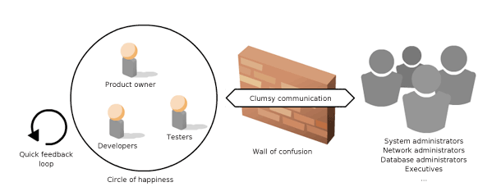
The Division Wall!
Copyright © 2014-2015 Xebia. All rights reserved. Not to be reproduced without prior written consent.

Slide 36
It’s A Cultural Change
Started as devOps days in Belgium in 2009.
Developers interested in cloud, clusters, servers, deployments, databases learn to write code to maintain them.
Ops people evolve and start developing the code to maintain infrastructure.
And they are all in one same dev team trying to achieve ONE GOAL!
Copyright © 2014-2015 Xebia. All rights reserved. Not to be reproduced without prior written consent.

Slide 37
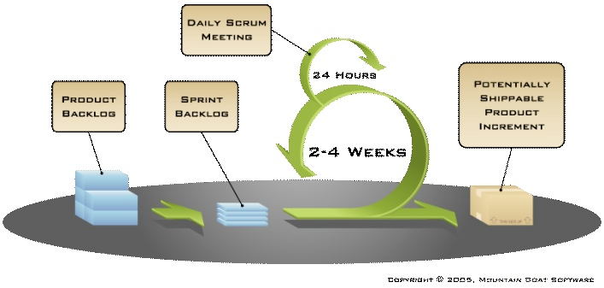


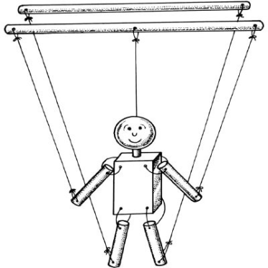


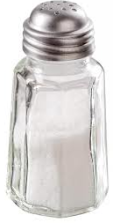
Why DevOps is gaining popularity?
Notes:
Agile
Cloud – VMs..
Could be done with actual hardware also.. Like HP has iLOs.. Or PXE Boot and stuff..
Configuration Management Tools
Increased rate of production releases by management

Slide 38
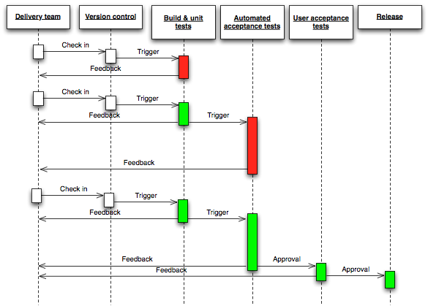
Copyright © 2014-2015 Xebia. All rights reserved. Not to be reproduced without prior written consent.
Notes:
Add Complete Agenda Here

Slide 39
Challenges?
Copyright © 2014-2015 Xebia. All rights reserved. Not to be reproduced without prior written consent.

Slide 40
End Chapter 1
Copyright © 2014-2015 Xebia. All rights reserved. Not to be reproduced without prior written consent.

Slide 41
Chapter 2
Deep Dive into TDD
Copyright © 2014-2015 Xebia. All rights reserved. Not to be reproduced without prior written consent.

Slide 42
What is TDD ?
TDD is an evolutionary approach to development which combines test-first development where you write a test before you write just enough production code to fulfill that test and refactoring.
Test-driven development (TDD) is an advanced technique of using automated unit tests to drive the design of software and force decoupling of dependencies. The result of using this practice is a comprehensive suite of unit tests that can be run at any time to provide feedback that the software is still working. This technique is heavily emphasized by those using Agile development methodologies
Copyright © 2014-2015 Xebia. All rights reserved. Not to be reproduced without prior written consent.

Slide 43
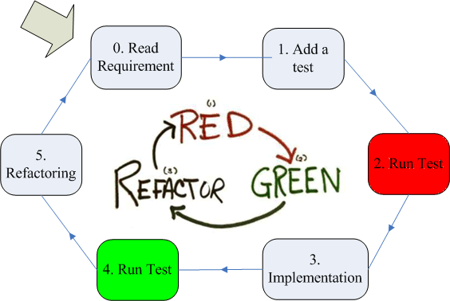
Doing TDD
source : javornikolov.github.io
Copyright © 2014-2015 Xebia. All rights reserved. Not to be reproduced without prior written consent.

Slide 44
Demo
Copyright © 2014-2015 Xebia. All rights reserved. Not to be reproduced without prior written consent.

Slide 45
Ping Pong Concept
A technique called “ping-pong programming” when one person writes a test, and another implements it. Then they switch.
Copyright © 2014-2015 Xebia. All rights reserved. Not to be reproduced without prior written consent.

Slide 46
Benefits of TDD
Forces us to make our code testable.
You will write more meaningful test cases covering more critical paths and not just for the code coverage.
Better design of application.
Speeds up development.
Copyright © 2014-2015 Xebia. All rights reserved. Not to be reproduced without prior written consent.

Slide 47
Mocks & Stubs
Copyright © 2014-2015 Xebia. All rights reserved. Not to be reproduced without prior written consent.

Slide 48
Mocks & Stubs
Stubs : an object that implements an interface of a component, but instead of returning what the component would return when called, the stub can be configured to return a value that suits the test
Using stubs a unit test can test if a unit can handle various return values from its collaborator
Mock : is like a stub, only it also has methods that make it possible determine what methods were called on the Mock
Using a mock it is thus possible to test
if the unit can handle various return values correctly
if the unit uses the collaborator correctly
Copyright © 2014-2015 Xebia. All rights reserved. Not to be reproduced without prior written consent.

Slide 49
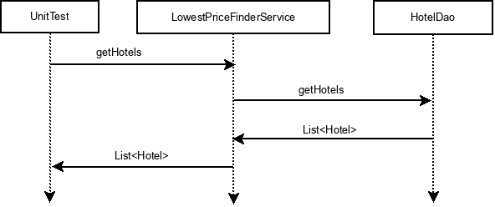
Mocks & Stubs
Mock can make test fail, stub not
Mocking frameworks can be used to create Stubs
State vs Behavior Verification
Stubs : Controlled values
Mocks : Verify behavior
Example : LowestPriceFinderServiceTest
Copyright © 2014-2015 Xebia. All rights reserved. Not to be reproduced without prior written consent.

Slide 50
What to Mock
If an actual object has any of the following characteristics, it may be useful to use a mock object in its place:
the object supplies non-deterministic results (e.g., the current time or the current temperature)
it has states that are difficult to create or reproduce (e.g., a network error)
it is slow (e.g., a complete database, which would have to be initialized before the test)
it does not yet exist or may change behavior
Copyright © 2014-2015 Xebia. All rights reserved. Not to be reproduced without prior written consent.

Slide 51
What to Mock
Objects or pieces of code you don’t need to test
A good rule of thumb is to mock as close to the source as possible
If you have a function call that calls an external API, mock out the external API, not the whole function
Similarly, don’t mock return values when you could construct a real return value of the correct type with the correct attributes
Copyright © 2014-2015 Xebia. All rights reserved. Not to be reproduced without prior written consent.

Slide 52
What NOT to Mock
You should not use mocking when you are interested in
Data that comes from external resources or the DB
Transactions
The interaction of your application with your application server or environment
Testing multiple modules together as a single
If you actually want to see the interaction of the whole module then you need integration tests
Copyright © 2014-2015 Xebia. All rights reserved. Not to be reproduced without prior written consent.

Slide 53
Overusing Mocks
Problems with overusing mocks
Tests can be harder to understand
Need to include extra code to tell the mocks how to behave
Having this extra code detracts from the actual intent of what you’re trying to test
Tests can be harder to maintain
When you tell a mock how to behave, you're leaking implementation details of your code into your test. When implementation details in your production code change, you'll need to update your tests to reflect these changes
Copyright © 2014-2015 Xebia. All rights reserved. Not to be reproduced without prior written consent.

Slide 54
How much to Mock
Some signs that you're overusing mocks
Mocking out more than two classes
Mocks specifies how more than two methods should behave
Copyright © 2014-2015 Xebia. All rights reserved. Not to be reproduced without prior written consent.

Slide 55
Best Practices
Don’t mock your model
Don’t mock servlet api
org.springframework.mock.web
Don’t replace asserts with verify
If it doesn’t contain asserts, and instead contains a long list of verify() calls, then you’re relying on side effects
This is a unit-test bad smell, especially if there are several objects that need to be verified
Copyright © 2014-2015 Xebia. All rights reserved. Not to be reproduced without prior written consent.

Slide 56
Best Practices
Mock across architecturally significant boundaries. For example, mock out the database, web server, and any external service
Copyright © 2014-2015 Xebia. All rights reserved. Not to be reproduced without prior written consent.

Slide 57


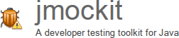


Common Frameworks
Copyright © 2014-2015 Xebia. All rights reserved. Not to be reproduced without prior written consent.

Slide 58
Data Mothers
Demo
Copyright © 2014-2015 Xebia. All rights reserved. Not to be reproduced without prior written consent.

Slide 59
Coverage Metrics and Tools
Copyright © 2014-2015 Xebia. All rights reserved. Not to be reproduced without prior written consent.

Slide 60
Code Coverage
Code coverage consists of a set of software metrics that can tell you how much of the production code is covered by a given test suite.
It's purely quantitative, and does not say anything about the quality of either the production code or the test code. That said, the examination of code coverage reports will sometimes lead to the discovery of unreachable code which can be eliminated. But more importantly, such reports can be used as a guide for the discovery of missing tests.
This is not only useful when creating tests for existing production code, but also when writing tests first, such as in the practice of TDD (Test Driven Development).
source : http://jmockit.googlecode.com
Copyright © 2014-2015 Xebia. All rights reserved. Not to be reproduced without prior written consent.

Slide 61
Cobertura
Demo.
Copyright © 2014-2015 Xebia. All rights reserved. Not to be reproduced without prior written consent.

Slide 62
Line Coverage
The line coverage metric tells us how much of the executable code in a source file has been exercised by tests. Each executable line of code can be uncovered, covered, or partially covered.
In the first case, none of the executable code in it was executed at all. In the second, all of the code was fully executed at least once. In the third case, only part of the executable code in the line was executed. This can happen, for example, with lines of code containing multiple logical conditions in a complex boolean expression.
source : http://jmockit.googlecode.com
Copyright © 2014-2015 Xebia. All rights reserved. Not to be reproduced without prior written consent.

Slide 63
Branch Coverage
A branching point exists wherever the program makes a decision between two possible execution paths to follow. Any line of code containing a logical condition will be divided in at least two executable segments, each belonging to a separate branch.
An executable line of source code with no branching points contains a single segment. Lines with one or more branching points contain two or more executable segments, separated by consecutive branching points in the line.
source : http://jmockit.googlecode.com
Copyright © 2014-2015 Xebia. All rights reserved. Not to be reproduced without prior written consent.

Slide 64
Testing Legacy Code
Copyright © 2014-2015 Xebia. All rights reserved. Not to be reproduced without prior written consent.

Slide 65
What do you mean by Legacy Code?
Copyright © 2014-2015 Xebia. All rights reserved. Not to be reproduced without prior written consent.

Slide 66
When do you encounter it ?
Copyright © 2014-2015 Xebia. All rights reserved. Not to be reproduced without prior written consent.

Slide 67
Bug Fixes
New Features
Re Factoring
Copyright © 2014-2015 Xebia. All rights reserved. Not to be reproduced without prior written consent.

Slide 68
Scenario’s
Copyright © 2014-2015 Xebia. All rights reserved. Not to be reproduced without prior written consent.

Slide 69
Pre DI Era
Copyright © 2014-2015 Xebia. All rights reserved. Not to be reproduced without prior written consent.

Slide 70
Mock Public Methods
Copyright © 2014-2015 Xebia. All rights reserved. Not to be reproduced without prior written consent.

Slide 71
Mock Private Methods
Copyright © 2014-2015 Xebia. All rights reserved. Not to be reproduced without prior written consent.

Slide 72
Mock Static Methods
Copyright © 2014-2015 Xebia. All rights reserved. Not to be reproduced without prior written consent.

Slide 73
Mock Constructors
Copyright © 2014-2015 Xebia. All rights reserved. Not to be reproduced without prior written consent.

Slide 74
Demo
Copyright © 2014-2015 Xebia. All rights reserved. Not to be reproduced without prior written consent.

Slide 75
What if I do NOT do
TDD/Unit Tests
Copyright © 2014-2015 Xebia. All rights reserved. Not to be reproduced without prior written consent.

Slide 76
End Chapter 2
Copyright © 2014-2015 Xebia. All rights reserved. Not to be reproduced without prior written consent.

Slide 77
Break - 15 mins
Copyright © 2014-2015 Xebia. All rights reserved. Not to be reproduced without prior written consent.

Slide 78
Chapter 3
Deep Dive into TDD Contd.
Copyright © 2014-2015 Xebia. All rights reserved. Not to be reproduced without prior written consent.

Slide 79
DAOTest
Copyright © 2014-2015 Xebia. All rights reserved. Not to be reproduced without prior written consent.

Slide 80
H2 Database
In Memory Database
Very fast, open source
Small footprint : ~1.5MB jar
Compatibility Modes
DB2
Derby
HSQLDB
Oracle
PostgreSQL
MS SQL
MySQL
Supported Platforms
Windows, Mac OS X and Linux
Copyright © 2014-2015 Xebia. All rights reserved. Not to be reproduced without prior written consent.

Slide 81
H2 Database
In some cases, only one connection to a in-memory database is required; database URL is “jdbc:h2:mem”
Opening two connections within the same virtual machine means opening two different (private) databases
Sometimes multiple connections to the same in-memory database are required; database URL is “jdbc:h2:mem:db1”
Accessing the same database using this URL only works within the same virtual machine
To access an in-memory database from another process or from another computer, you need to start a TCP server in the same process as the in-memory database was created; “jdbc:h2:tcp://localhost/mem:db1”
Copyright © 2014-2015 Xebia. All rights reserved. Not to be reproduced without prior written consent.

Slide 82
H2 Database
By default, closing the last connection to a database closes the database
For an in-memory database, this means the content is lost. To keep the database open, add ;DB_CLOSE_DELAY=-1 to the database URL
To keep the content of an in-memory database as long as the virtual machine is alive, use “jdbc:h2:mem:test;DB_CLOSE_DELAY=-1”
Copyright © 2014-2015 Xebia. All rights reserved. Not to be reproduced without prior written consent.

Slide 83
Demo
Copyright © 2014-2015 Xebia. All rights reserved. Not to be reproduced without prior written consent.

Slide 84
Function & SPs
H2 database supports user-defined Java functions. Java functions can be used as stored procedures as well
A function must be declared (registered) before it can be used
A function can be defined using source code, or as a reference to a compiled class that is available in the classpath
Only static Java methods are supported; both the class and the method must be public
Copyright © 2014-2015 Xebia. All rights reserved. Not to be reproduced without prior written consent.

Slide 85
Demo
Copyright © 2014-2015 Xebia. All rights reserved. Not to be reproduced without prior written consent.

Slide 86
REST/SOAP/Controllers
Copyright © 2014-2015 Xebia. All rights reserved. Not to be reproduced without prior written consent.

Slide 87
Integration Tests
Copyright © 2014-2015 Xebia. All rights reserved. Not to be reproduced without prior written consent.

Slide 88
Unit Tests
Business Services
Controllers
DAO’s
Copyright © 2014-2015 Xebia. All rights reserved. Not to be reproduced without prior written consent.

Slide 89
Integration Tests
Controllers
Business Services
Business Services
Controllers
Business Services
DAO’s
DAO’s
Note :- Integration test can be between two classes of the same layer also.
Copyright © 2014-2015 Xebia. All rights reserved. Not to be reproduced without prior written consent.

Slide 90
Integration Tests
Test the correct inter-operation of multiple subsystems. There is whole spectrum there, from testing integration between two classes, to testing integration with the production environment.
Smoke test: A simple integration test where we just check that when the system under test is invoked it returns normally and does not blow up. It is an analogy with electronics, where the first test occurs when powering up a circuit: if it smokes, it's bad.
Acceptance test: Test that a feature or use case is correctly implemented. It is similar to an integration test, but with a focus on the use case to provide rather than on the components involved.
Regression test: A test that was written when a bug was fixed. It ensure that this specific bug will not occur again. The full name is "non-regression test".
Copyright © 2014-2015 Xebia. All rights reserved. Not to be reproduced without prior written consent.

Slide 91
Integration Tests
Embedded Web Server - Tomcat / Jetty
Integration Tests Configuration in POM
Copyright © 2014-2015 Xebia. All rights reserved. Not to be reproduced without prior written consent.

Slide 92
Demo - SpringIT
Copyright © 2014-2015 Xebia. All rights reserved. Not to be reproduced without prior written consent.

Slide 93
Demo - RESTIT
Copyright © 2014-2015 Xebia. All rights reserved. Not to be reproduced without prior written consent.

Slide 94
Demo - SOAPIT
Copyright © 2014-2015 Xebia. All rights reserved. Not to be reproduced without prior written consent.

Slide 95
End Chapter 3
Copyright © 2014-2015 Xebia. All rights reserved. Not to be reproduced without prior written consent.

Slide 96
Lunch
Copyright © 2014-2015 Xebia. All rights reserved. Not to be reproduced without prior written consent.

Slide 97
Chapter 4
Deep Dive into BDD
Copyright © 2014-2015 Xebia. All rights reserved. Not to be reproduced without prior written consent.

Slide 98
Behavior Driven Development
•BDD is focused at intent rather than code as in case of TDD.
•At its core, behavior-driven development is a specialized version of test-driven development which focuses on behavioral specification.
•BDD is a vehicle for communication between all the different roles in a software project
•Outside-in: What’s the next most important thing the system doesn’t do?
Copyright © 2014-2015 Xebia. All rights reserved. Not to be reproduced without prior written consent.

Slide 99
Behavior Driven Development
•Format: BDD chooses to use a semi-formal format for behavioral specification which is borrowed from user story specifications
•Given some initial context (the givens),
When an event occurs,
then ensure some outcomes.
•A story’s behavior is simply its acceptance criteria.
•Language: A ubiquitous language is a (semi-)formal language that is shared by all members of a software development team.
Copyright © 2014-2015 Xebia. All rights reserved. Not to be reproduced without prior written consent.

Slide 100
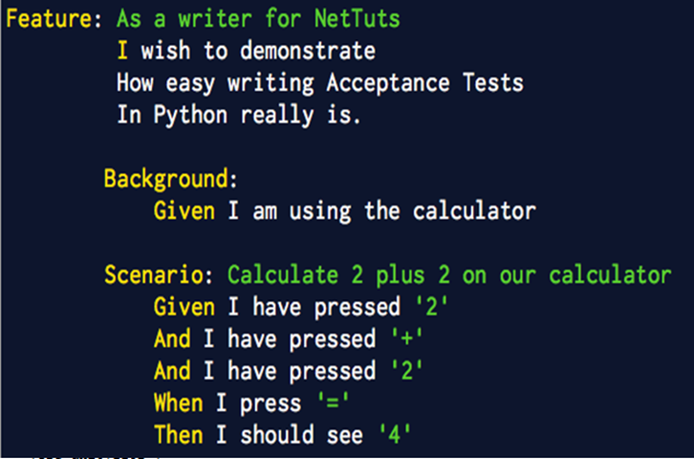
Behavior Driven Development
Copyright © 2014-2015 Xebia. All rights reserved. Not to be reproduced without prior written consent.

Slide 101
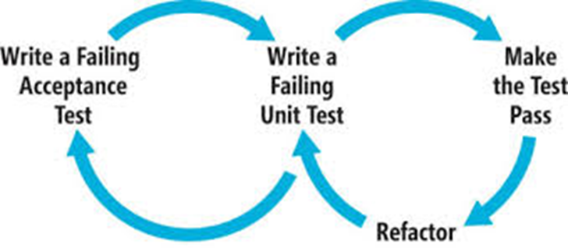
Behavior Driven Development
Copyright © 2014-2015 Xebia. All rights reserved. Not to be reproduced without prior written consent.

Slide 102
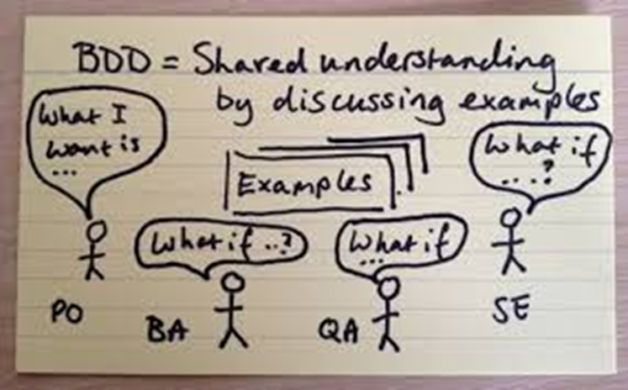
Behavior Driven Development
Copyright © 2014-2015 Xebia. All rights reserved. Not to be reproduced without prior written consent.

Slide 103
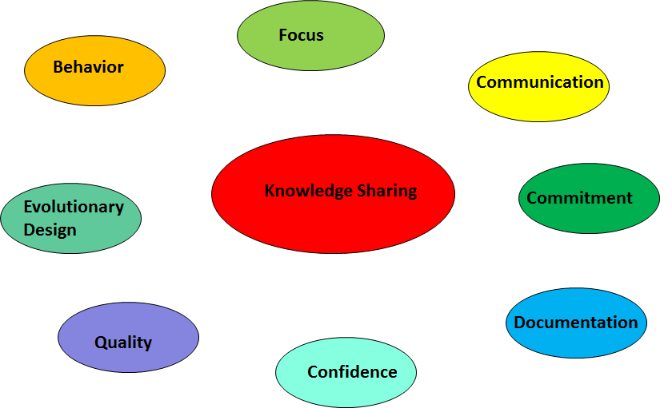
Advantages of BDD
Copyright © 2014-2015 Xebia. All rights reserved. Not to be reproduced without prior written consent.

Slide 104
You Need to be Cautious for
•Communication
•Testing ( Need to be Automated)
•Handling Change in Requirements?
•If only QA is following BDD ?
•Are you writing code keeping in mind Feature files and also the BDD Test?
•What’s the overall cost?
•What if PO/BA breaks the build often? ( while committing feature files)
Copyright © 2014-2015 Xebia. All rights reserved. Not to be reproduced without prior written consent.

Slide 105
Cucumber
Copyright © 2014-2015 Xebia. All rights reserved. Not to be reproduced without prior written consent.

Slide 106
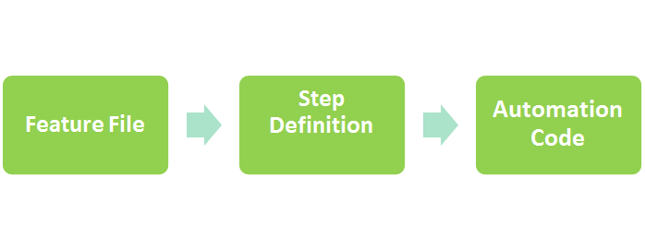
Introduction to Cucumber
Copyright © 2014-2015 Xebia. All rights reserved. Not to be reproduced without prior written consent.

Slide 107
Introduction to Cucumber
•Cucumber : Tool to implement BDD.
•Feature file: Behavior of the system with natural language with some specific keywords.
•Step Definitions: Explain Cucumber what to do when finding that step in one of the feature files.
•Automation Code:The Last Step is to write the code which Step Definitions are going to call.
Copyright © 2014-2015 Xebia. All rights reserved. Not to be reproduced without prior written consent.

Slide 108
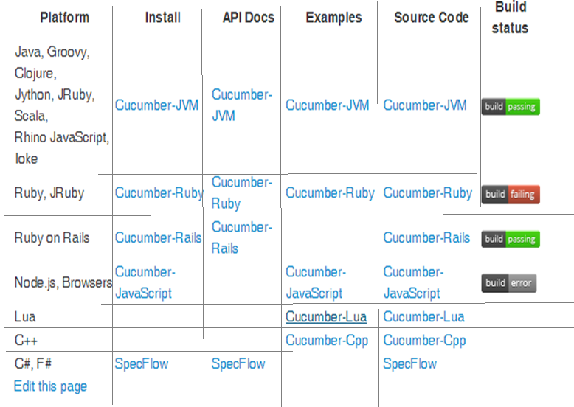
Cucumber Platforms
Copyright © 2014-2015 Xebia. All rights reserved. Not to be reproduced without prior written consent.

Slide 109
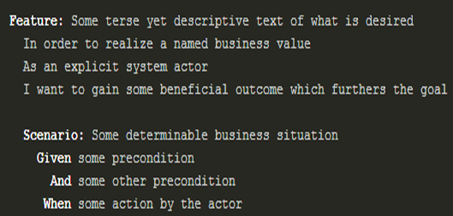
Gherkin Language
•Gherkin is line-oriented language that uses indentation to define structure.
•Lines in Gherkin start with a special keyword and Line endings terminate
statements (called steps)
Copyright © 2014-2015 Xebia. All rights reserved. Not to be reproduced without prior written consent.

Slide 110
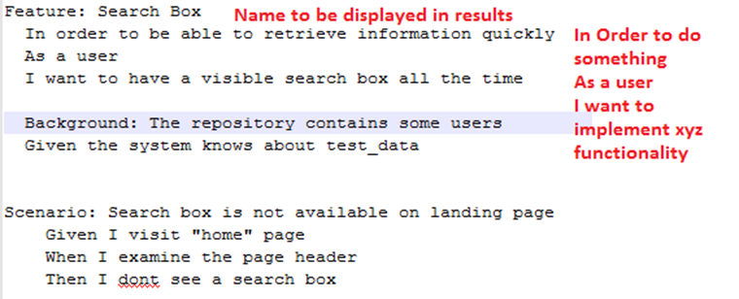
Feature File
•Feature file contains multiple Scenarios
•Each Scenario is a Test Case
•Lines starting with the keyword Feature followed by three indented lines starts a
feature.
Copyright © 2014-2015 Xebia. All rights reserved. Not to be reproduced without prior written consent.

Slide 111
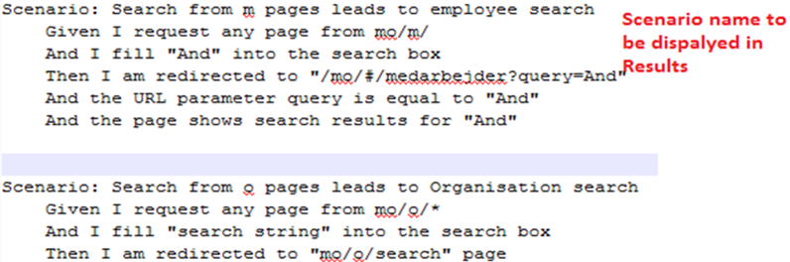
Scenario
•Every scenario starts with the keyword Scenario
•Followed by an optional scenario Title. ( Title Would be displayed in the Results)
•Each feature can have one or more scenarios, and every scenario consists
of one or more
steps.
Copyright © 2014-2015 Xebia. All rights reserved. Not to be reproduced without prior written consent.

Slide 112
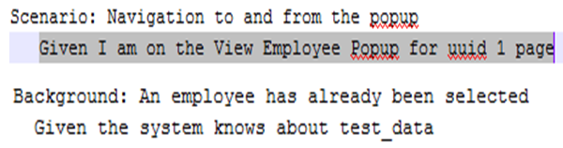
Step - Given
•Scenarios consist of steps Given, When and Then.
•The purpose of Given steps is to put the system in a known state before the user (or external system) starts interacting with the system .
•Similar to Pre Conditions of the use cases.
•Avoid talking about user interaction in givens.
Copyright © 2014-2015 Xebia. All rights reserved. Not to be reproduced without prior written consent.

Slide 113
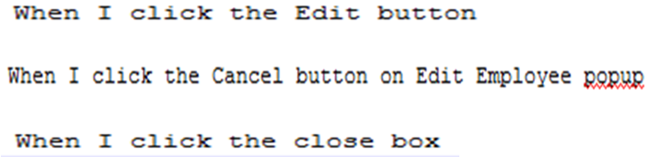
Step - When
•The purpose of When steps is to describe the key action the user performs.
Copyright © 2014-2015 Xebia. All rights reserved. Not to be reproduced without prior written consent.

Slide 114
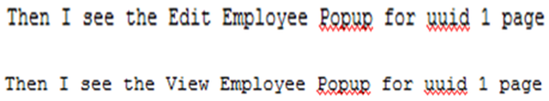
Step - Then
•The purpose of Then steps is to observe outcomes.
•The observations should be related to the business value/benefit in your feature description.
Copyright © 2014-2015 Xebia. All rights reserved. Not to be reproduced without prior written consent.

Slide 115
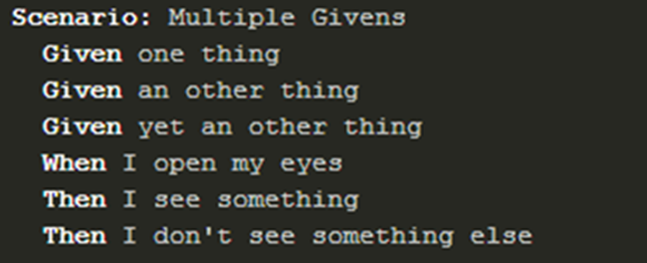
Step - And & But
•If you have several Given, When or Then steps you can write:
Copyright © 2014-2015 Xebia. All rights reserved. Not to be reproduced without prior written consent.

Slide 116
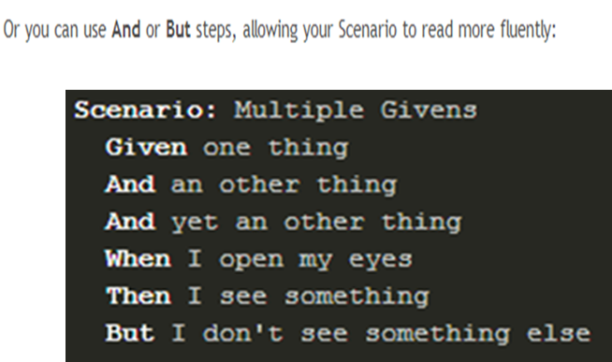
Step - And & But
Copyright © 2014-2015 Xebia. All rights reserved. Not to be reproduced without prior written consent.

Slide 117
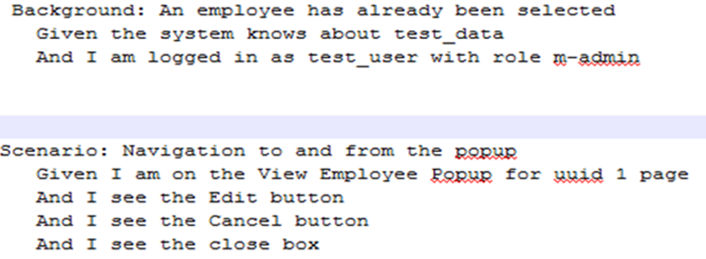
Background
•A Background is like an untitled scenario, containing a number of steps.
•The difference is when it is run: the background is run before each of your scenarios, but after your BeforeScenario hooks .
Copyright © 2014-2015 Xebia. All rights reserved. Not to be reproduced without prior written consent.

Slide 118
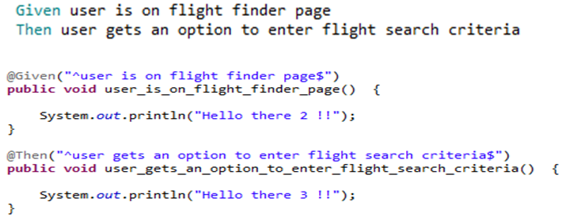
Step Definitions
•When Cucumber executes a Step in a Scenario it will look for a matching Step Definition to execute.
Copyright © 2014-2015 Xebia. All rights reserved. Not to be reproduced without prior written consent.

Slide 119
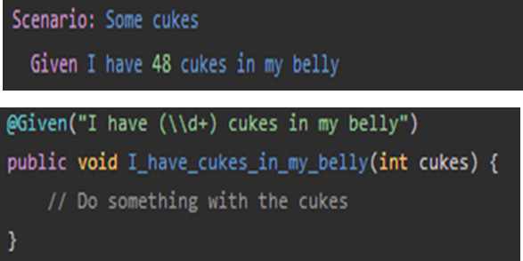
Step Definitions - Reg Ex
•When Cucumber matches a Step against a regular expression in a Step Definition, it passes the value of all the capture groups to the Step Definition’s arguments.
Copyright © 2014-2015 Xebia. All rights reserved. Not to be reproduced without prior written consent.

Slide 120
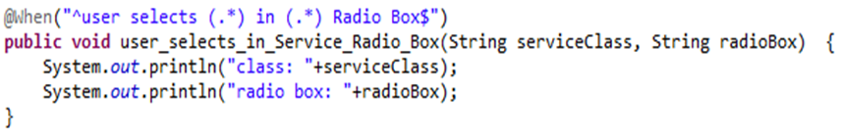
Step Definitions - Reg Ex
•By Default Capture groups are strings (even when they match digits like (\\d+). You can specify the Argument type Specifically also.
Copyright © 2014-2015 Xebia. All rights reserved. Not to be reproduced without prior written consent.

Slide 121
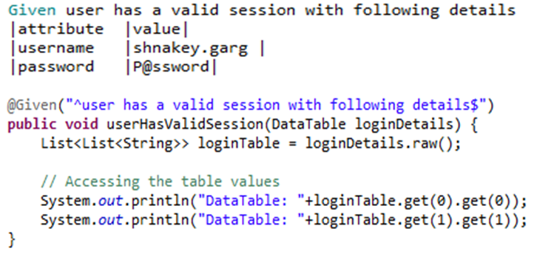
Data Tables
•Tables as arguments to steps are handy for specifying a larger data set.
•Data Tables will be passed to the Step Definition as the last argument.
Copyright © 2014-2015 Xebia. All rights reserved. Not to be reproduced without prior written consent.

Slide 122
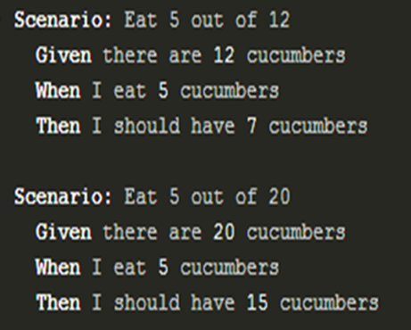
Scenario Outline
•Copying and pasting scenarios to use different values can quickly become tedious and repetitive.
•Consider this example:
Copyright © 2014-2015 Xebia. All rights reserved. Not to be reproduced without prior written consent.

Slide 123
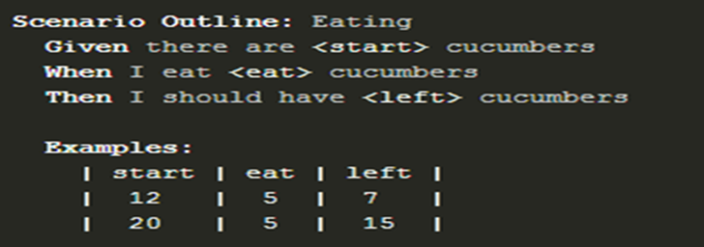
Scenario Outline
•A Scenario Outline is run once for each row in the Examples section beneath it (not counting the first row of column headers).
Copyright © 2014-2015 Xebia. All rights reserved. Not to be reproduced without prior written consent.

Slide 124
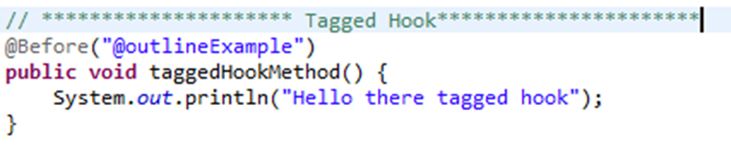
Tagged Hooks
•We can also indicate that @Before and @After only run with scenarios with certain tags e.x. @Before(‘@web’) for tests needing a browser launched
•Tagged hooks can have multiple tags, and follow similar tagging AND/OR rules that the runner does
Copyright © 2014-2015 Xebia. All rights reserved. Not to be reproduced without prior written consent.

Slide 125

Running Cucumber via Junit
•Create one empty class with the @RunWith(Cucumber.class) annotation.
• Executing this class as any JUnit test class will run all features found on the classpath in the same package as this class.
•The options to be used are defined with the @CucumberOptions
Copyright © 2014-2015 Xebia. All rights reserved. Not to be reproduced without prior written consent.

Slide 126

@Cucumber Options
Copyright © 2014-2015 Xebia. All rights reserved. Not to be reproduced without prior written consent.

Slide 127

Cucumber Reports
•Cucumber can report results in several different formats, using formatters.
•Formatters are specified either on the command line or in code.
•Pretty
•Prints the gherkin source with additional colours and stack traces for errors
•HTML
•This report is handy for publishing
Copyright © 2014-2015 Xebia. All rights reserved. Not to be reproduced without prior written consent.

Slide 128
Cucumber Reports
JSON
This report contains all the information from the gherkin source, with additional results for each step, including embedded screenshots. This report is meant to be post-processed into another visual format by 3rd party tools such as Cucumber Jenkins.
JUnit
This report generates XML files just like Apache Ant’s junit Report task. This XML format is understood by most Continuous Integration servers, who will use it to generate visual reports.
Copyright © 2014-2015 Xebia. All rights reserved. Not to be reproduced without prior written consent.

Slide 129

Screen Shots
•Cucumber itself doesn’t provide an API to take screenshots or videos, but it provides an API to embed them into the report.
•For example, if you are using Selenium WebDriver, you can ask it to give you a screenshot, and then embed them into the report.
Copyright © 2014-2015 Xebia. All rights reserved. Not to be reproduced without prior written consent.

Slide 130
Run Cucumber from Command Line
•mvn test
Run only few files:
•mvn test -Dcucumber.options="--tags @wip"
Copyright © 2014-2015 Xebia. All rights reserved. Not to be reproduced without prior written consent.

Slide 131

Debugging
•When a Scenario Fails, cucumber generates a fail report which can track us to the actual failing line of code.
•Order
•Application code → Glue Code → Feature File
Copyright © 2014-2015 Xebia. All rights reserved. Not to be reproduced without prior written consent.

Slide 132
Demo
Copyright © 2014-2015 Xebia. All rights reserved. Not to be reproduced without prior written consent.

Slide 133
End Chapter 4
Copyright © 2014-2015 Xebia. All rights reserved. Not to be reproduced without prior written consent.

Slide 134
Chapter 5
Clean Code, Refactoring
Pair Programming & Design Patterns
Copyright © 2014-2015 Xebia. All rights reserved. Not to be reproduced without prior written consent.

Slide 135

Copyright © 2014-2015 Xebia. All rights reserved. Not to be reproduced without prior written consent.

Slide 136
What is Clean Code?
Copyright © 2014-2015 Xebia. All rights reserved. Not to be reproduced without prior written consent.

Slide 137
Clean Code is maintainable
Source code:
readable
well structured
extensible
testable
maintainable
Copyright © 2014-2015 Xebia. All rights reserved. Not to be reproduced without prior written consent.

Slide 138
Meaningful Names
Copyright © 2014-2015 Xebia. All rights reserved. Not to be reproduced without prior written consent.

Slide 139
Meaningful Names
Explicit : Name of an element should tell the purpose of its existence, how will it be used, where it will be used etc.
Copyright © 2014-2015 Xebia. All rights reserved. Not to be reproduced without prior written consent.

Slide 140

Copyright © 2014-2015 Xebia. All rights reserved. Not to be reproduced without prior written consent.

Slide 141
Meaningful Names
Distinct and Clear : Name of elements should not be generalized and should be distinct such that it distinguishes itself from similar elements
Copyright © 2014-2015 Xebia. All rights reserved. Not to be reproduced without prior written consent.

Slide 142

Copyright © 2014-2015 Xebia. All rights reserved. Not to be reproduced without prior written consent.

Slide 143
Meaningful Names
Class Names : should be nouns e.g. Account, Vehicle, Employee
Function names : should be verbs e.g. transferMoney, validate, authenticate etc.
Factory Methods Vs Constructors : Use Factory Methods instead of Constructors e.g.Employee.createWithDefaultValues()
Copyright © 2014-2015 Xebia. All rights reserved. Not to be reproduced without prior written consent.

Slide 144
Meaningful Names
One Word Per Context
Pick one word per context and the whole team should agree to it e.g. don’t use findByName and fetchByEmail together in the same project.
Don’t Add Unnecessary Prefixes
Don’t prefix your class names with name of the modules eg BBAccountCreationService, BBUserAuthenticationService.
Copyright © 2014-2015 Xebia. All rights reserved. Not to be reproduced without prior written consent.

Slide 145
Classes
Copyright © 2014-2015 Xebia. All rights reserved. Not to be reproduced without prior written consent.

Slide 146
Classes
Small : lines vs responsibilities
Single Responsibility Principle (SRP) : Only one reason to change
Cohesion : variables and functions
Copyright © 2014-2015 Xebia. All rights reserved. Not to be reproduced without prior written consent.

Slide 147
Functions
Copyright © 2014-2015 Xebia. All rights reserved. Not to be reproduced without prior written consent.

Slide 148
Functions
The first rule of functions is that they should be small
The second rule of functions is that they should be smaller than that
Copyright © 2014-2015 Xebia. All rights reserved. Not to be reproduced without prior written consent.

Slide 149
Functions
Flag Arguments
Argument Objects
Side Effects
Command Query Separation
Demo : UserValidator
Copyright © 2014-2015 Xebia. All rights reserved. Not to be reproduced without prior written consent.

Slide 150
Code Smells
Copyright © 2014-2015 Xebia. All rights reserved. Not to be reproduced without prior written consent.

Slide 151

Copyright © 2014-2015 Xebia. All rights reserved. Not to be reproduced without prior written consent.

Slide 152
Payroll Demo
Copyright © 2014-2015 Xebia. All rights reserved. Not to be reproduced without prior written consent.

Slide 153
Pair Programming
Copyright © 2014-2015 Xebia. All rights reserved. Not to be reproduced without prior written consent.

Slide 154

Pair Programming
Two team members working on
the same task
Both have same target
Both have different expertise
One is driver and other is navigator
Pair programming increases software quality without impacting time to deliver
Copyright © 2014-2015 Xebia. All rights reserved. Not to be reproduced without prior written consent.

Slide 155
Isn’t it a waste?
Two developers will do the work of one
Junior guys will slow down seniors
Less work will get done
My cost will double
Why would I put two people on a job that just one can do?
Copyright © 2014-2015 Xebia. All rights reserved. Not to be reproduced without prior written consent.

Slide 156





Copyright © 2014-2015 Xebia. All rights reserved. Not to be reproduced without prior written consent.

Slide 157
When should you Pair?
Complex Code
Mission Critical Code
Code that involves design decisions
Areas of code that you want everyone on the team to know
Copyright © 2014-2015 Xebia. All rights reserved. Not to be reproduced without prior written consent.

Slide 158
What is NOT pair programming?
Splitting up the work
Taking turns doing the work
One person doing all the work
Being located in different places
Sitting at different computers (Exception - Remote shared desktop if absolutely necessary)
Copyright © 2014-2015 Xebia. All rights reserved. Not to be reproduced without prior written consent.

Slide 159
How does it help?
Less Defects, caught early
Continuous Review
Better Problem Solving
Better Design
Hands on approach to learning
Better induction of new team member
“Pair-Pressure” ensures timely delivery
Copyright © 2014-2015 Xebia. All rights reserved. Not to be reproduced without prior written consent.

Slide 160
How do we do it?
Copyright © 2014-2015 Xebia. All rights reserved. Not to be reproduced without prior written consent.

Slide 161
Ping Pong Concept
Copyright © 2014-2015 Xebia. All rights reserved. Not to be reproduced without prior written consent.

Slide 162
Chess/Kitchen Clock
Copyright © 2014-2015 Xebia. All rights reserved. Not to be reproduced without prior written consent.

Slide 163
Any Rules?
Copyright © 2014-2015 Xebia. All rights reserved. Not to be reproduced without prior written consent.

Slide 164
Think Out Loud
Copyright © 2014-2015 Xebia. All rights reserved. Not to be reproduced without prior written consent.

Slide 165
Ten Seconds
Copyright © 2014-2015 Xebia. All rights reserved. Not to be reproduced without prior written consent.

Slide 166
Refactoring
“Any fool can write code that a computer can understand. Good programmers write code that humans can understand.” - Martin Fowler
Copyright © 2014-2015 Xebia. All rights reserved. Not to be reproduced without prior written consent.

Slide 167
Refactoring
“A series of small steps, each of which changes the program’s internal structure without changing its external behavior.”
- Martin Fowler
Copyright © 2014-2015 Xebia. All rights reserved. Not to be reproduced without prior written consent.

Slide 168
Why Refactor?
Improves the design of our software
Easier to maintain and understand
Easier to facilitate change
More flexibility
Increased re-usability
Helps us deliver more business value faster
Copyright © 2014-2015 Xebia. All rights reserved. Not to be reproduced without prior written consent.

Slide 169
When to Refactor?
To add new functionality
Refactor existing code until you understand it
Refactor the design to make it simple
To find bugs
For code reviews
Immediate effect of code review
Copyright © 2014-2015 Xebia. All rights reserved. Not to be reproduced without prior written consent.

Slide 170
How?
IDEs have all the shortcuts
Rename
Move
Extract Methods, Local Variables, Constants
Inline Methods, Local Variables, Constants
Change Methods Signature
“quick assist” option
Copyright © 2014-2015 Xebia. All rights reserved. Not to be reproduced without prior written consent.

Slide 171

Boy scouts rule
Copyright © 2014-2015 Xebia. All rights reserved. Not to be reproduced without prior written consent.

Slide 172
Demo
Copyright © 2014-2015 Xebia. All rights reserved. Not to be reproduced without prior written consent.

Slide 173
Design Patterns
Copyright © 2014-2015 Xebia. All rights reserved. Not to be reproduced without prior written consent.

Slide 174
Gof Patterns?
Copyright © 2014-2015 Xebia. All rights reserved. Not to be reproduced without prior written consent.

Slide 175
Design Patterns
The terminology Design Pattern in software development is primary based on the book Design Patterns - “Elements of Reusable Object-Oriented Software”
- Erich Gamma, Richard Helm,
Ralph Johnson and John Vlissides
Copyright © 2014-2015 Xebia. All rights reserved. Not to be reproduced without prior written consent.

Slide 176
Gang of Four Patterns
Creational
Factory, AbstractFactory, Singleton, Object Pool
Structural
Adaptor, Proxy, Facade
Behavioural
Iterator, Observer, Strategy
Copyright © 2014-2015 Xebia. All rights reserved. Not to be reproduced without prior written consent.

Slide 177
Why use Design Patterns?
Design patterns are proven solutions /approaches to common problems
Common language for developers
Capture good practices
Based on the base principles of object orientated design
Copyright © 2014-2015 Xebia. All rights reserved. Not to be reproduced without prior written consent.

Slide 178
What do we get?
Copyright © 2014-2015 Xebia. All rights reserved. Not to be reproduced without prior written consent.

Slide 179

Copyright © 2014-2015 Xebia. All rights reserved. Not to be reproduced without prior written consent.

Slide 180
Technical Debt
Technical debt isn’t listed on your balance sheet, yet it can destroy your business
Often Products carry technical debt when they are difficult or risky to change
Copyright © 2014-2015 Xebia. All rights reserved. Not to be reproduced without prior written consent.

Slide 181
End Chapter 5
Copyright © 2014-2015 Xebia. All rights reserved. Not to be reproduced without prior written consent.

Slide 182
Break - 15 mins
Copyright © 2014-2015 Xebia. All rights reserved. Not to be reproduced without prior written consent.

Slide 183
Chapter 6
Deep Dive into CI
Copyright © 2014-2015 Xebia. All rights reserved. Not to be reproduced without prior written consent.

Slide 184

Software Delivery Challenges

Slide 185

Continuous Integration
CI Ecosystem
The main aim of CI is to prevent integration problems, referred to as integration hell .
Copyright © 2014-2015 Xebia. All rights reserved. Not to be reproduced without prior written consent.

Slide 186
Best Practices
Copyright © 2014-2015 Xebia. All rights reserved. Not to be reproduced without prior written consent.

Slide 187

Maintain a Code Repository
Copyright © 2014-2015 Xebia. All rights reserved. Not to be reproduced without prior written consent.

Slide 188

Commit Frequently, Integrate Regularly
Common Agile Branching Patterns :
Copyright © 2014-2015 Xebia. All rights reserved. Not to be reproduced without prior written consent.

Slide 189

Automate the Builds
Copyright © 2014-2015 Xebia. All rights reserved. Not to be reproduced without prior written consent.

Slide 190

Use a Central Binary Repository
Copyright © 2014-2015 Xebia. All rights reserved. Not to be reproduced without prior written consent.

Slide 191

Maintain Coding Standards..
Copyright © 2014-2015 Xebia. All rights reserved. Not to be reproduced without prior written consent.

Slide 192

Test Builds Periodically
Copyright © 2014-2015 Xebia. All rights reserved. Not to be reproduced without prior written consent.

Slide 193

Automated Deployments
Private Repositories
Prod
QA
Test
Dev
Copyright © 2014-2015 Xebia. All rights reserved. Not to be reproduced without prior written consent.

Slide 194
Most Important : Continuous Feedback !!

Slide 195
End Chapter 6
Copyright © 2014-2015 Xebia. All rights reserved. Not to be reproduced without prior written consent.

Slide 196
Chapter 7
Implementing CI CD
Copyright © 2014-2015 Xebia. All rights reserved. Not to be reproduced without prior written consent.

Slide 197

Challenged Web Environment
Copyright © 2014-2015 Xebia. All rights reserved. Not to be reproduced without prior written consent.

Slide 198

Why Mobile Too?

Slide 199

W.T.F.!
Copyright © 2014-2015 Xebia. All rights reserved. Not to be reproduced without prior written consent.

Slide 200


Voila! Continuous Delivery !

Slide 201

Ecosystem Agnostic !!

Slide 202
Demo
Copyright © 2014-2015 Xebia. All rights reserved. Not to be reproduced without prior written consent.

Slide 203
End Chapter 7
Copyright © 2014-2015 Xebia. All rights reserved. Not to be reproduced without prior written consent.

Slide 204
Chapter 8
Infrastructure as Code
Copyright © 2014-2015 Xebia. All rights reserved. Not to be reproduced without prior written consent.

Slide 205
Programmable Infrastructure ?
The idea of automating things is not new..
Hell I’ve been using BAT files and Shell scripts to do all sorts of things on my infrastructure for many years now.

Slide 206

Aren’t We Re-Inventing the WHEEL ?
Common Challenges:

Slide 207

Advent of Cloud Era..

Slide 208


Arise : Infra As Code
A Paradigm , that models your infrastructure in Code
Virtualized Infrastructure
Physical Infrastructure
Abstract Infrastructure

Slide 209


Abstraction of Infrastructure

Slide 210

Component Life-Cycle
Each Component has its own lifecycle
For Example: A software package object will have an install, upgrade and remove method.

Slide 211
From Blueprints to Architecture
Abstract Components + Lifecycle Methods =
Free Administrators from worrying about specific Implementation Details.
Focus more on orchestration and collaboration of Components.
Robust Underlying Architecture to get rid of device dependencies.

Slide 212


Advantages Over Legacy Controllers

Slide 213
Idempotent implementations
If f(x) =x
then
f(..f(f(x))=x

Slide 214

Auditing
Periodically running these idempotent operations results in auditing.

Slide 215
Version Controlled Infrastructure
Using Version Control Systems like git, we introduce versions of the infrastructure that can be maintained alongside the application code. If a new unstable version breaks something, the infrastructure can be reverted to a previous stable version.

Slide 216

Tools of the Trade..

Slide 217
Some Terminologies..
Java | Puppet | Chef
class *.java | manifests *.pp | recipes *.rb
package | module | cookbook

Slide 218
Questions and Answers

Slide 219
Feedback
your kind feedback is highly appreciated

Slide 220
End Chapter 8
Copyright © 2014-2015 Xebia. All rights reserved. Not to be reproduced without prior written consent.

Slide 221




Reference
Copyright © 2014-2015 Xebia. All rights reserved. Not to be reproduced without prior written consent.

